Slide 1
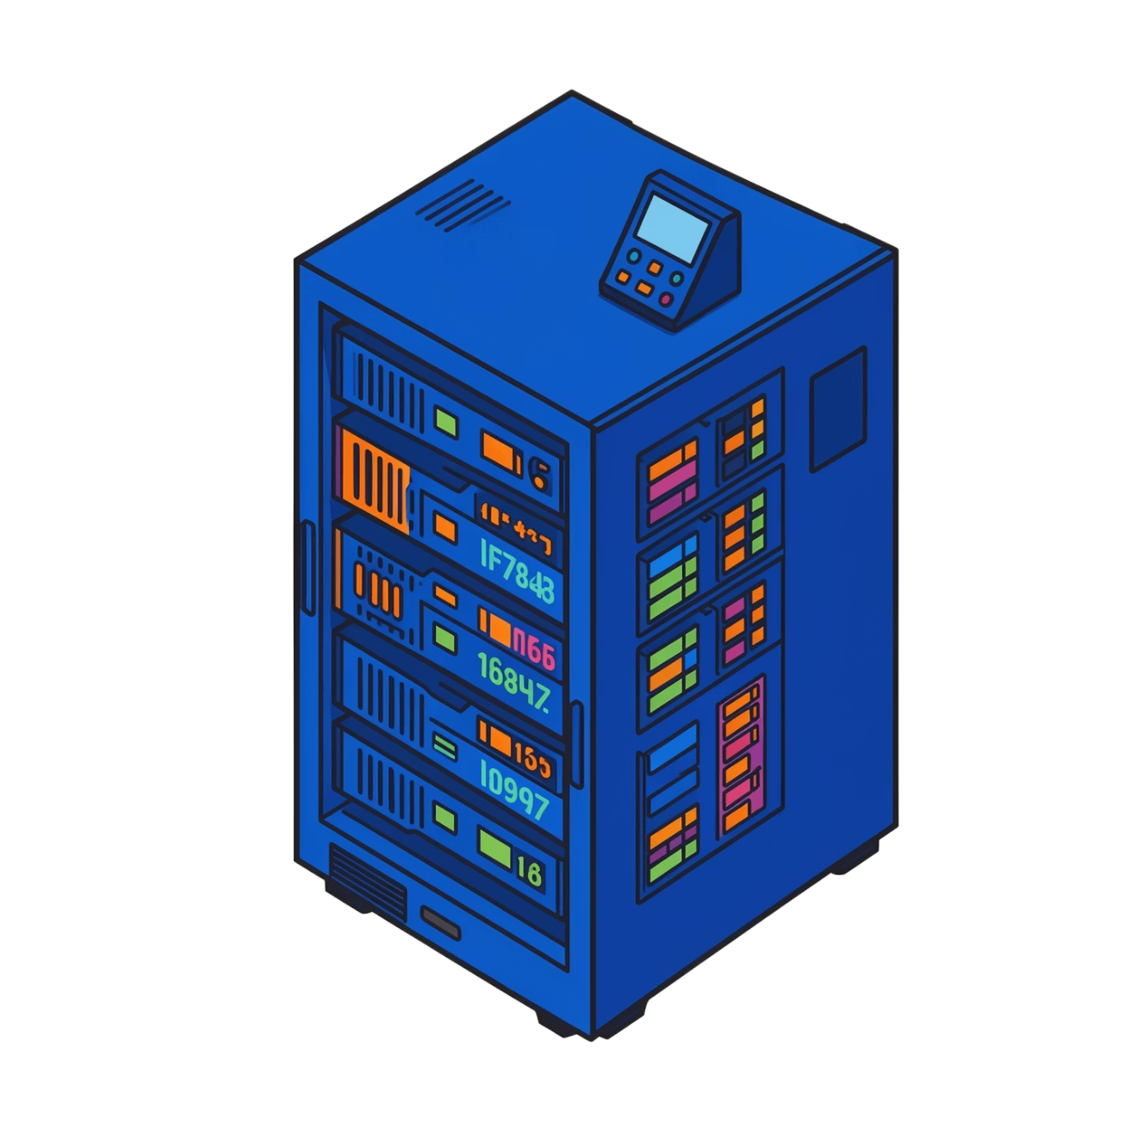

DBMS · FOUNDATIONS
Architecture of a Database Management System
How applications reach reliable data through layers of abstraction, processing, and storage.
First database course · systems view
Notes:
Introduce the deck as a systems view of a DBMS. We will move from what users see, through query processing, to the storage and reliability services underneath.

Slide 2


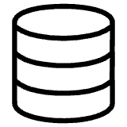
A DBMS is the layer between applications and data
It translates requests into controlled access to organized, shared information.
Applications and users
The DBMS
Data
Applications and users send requests.
The DBMS interprets, controls, and executes those requests.
Data stays organized, secure, and available to many users.
Notes:
Start with the basic boundary. Applications do not usually manage files, permissions, or concurrent access themselves. The DBMS sits between the request and the stored data, providing the control layer.

Slide 3
Three-schema architecture separates what users see from how data is stored
The same database can present different views while keeping one underlying structure.
01
External level
User-specific views of the database.
02
Conceptual level
The logical structure of the complete database.
03
Internal level
Physical storage structures and access paths.
Notes:
Read the stack from top to bottom. External schemas serve particular users or applications. The conceptual schema describes the whole logical database. The internal schema describes how that information is physically stored and accessed.

Slide 4
Data independence protects applications from database changes
Mappings between levels absorb many implementation changes.
PHYSICAL
LOGICAL
Physical data independence
Logical data independence
Change storage details without changing the logical schema.
Change the logical schema without rewriting every user view.
Example: reorganize files or add an index while applications keep using the same logical tables.
Example: extend the conceptual structure while preserving the views that users already rely on.
Notes:
Data independence is a protection boundary. Physical changes stay below the logical schema. Logical changes can be absorbed before they reach every external view. The application interface therefore changes less often than the database beneath it.

Slide 5
A query travels through a processing pipeline
Each stage narrows the distance between a request and a returned result.
01
02
03
04
Parse & validate
Plan
Run
Return
Check the SQL request for valid syntax and meaning.
Choose an efficient way to execute the request.
Apply the plan against stored data.
Send the result back to the application.
Notes:
Trace one query from left to right. The DBMS first understands the request, then chooses a strategy, performs the operations, and returns the result. The stages are distinct, but they work as one pipeline.

Slide 6



The query processor turns intent into an executable plan
Its job is to preserve correctness while using resources efficiently.
Parser
Optimizer
Executor
Checks syntax and meaning. It turns text into a structured representation the system can reason about.
Compares alternative strategies, such as different join orders or access paths.
Performs the selected operations and produces the requested result.
Notes:
Separate intent from execution. The parser asks whether the request makes sense. The optimizer chooses among valid strategies. The executor carries out that choice. Together they turn a declarative request into concrete work.

Slide 7






The storage manager makes data durable and safe
It organizes files, pages, records, and indexes; uses a buffer manager to move data between disk and memory; and coordinates transactions, concurrency, recovery, and authorization to protect consistency when many users work at once.
Storage Manager
Files, Pages, Records
Transactions & Recovery
Indexes
Buffer Manager
Organizes physical data layout
Speeds data lookup
Ensures atomicity and durability
Manages in-memory pages
Notes:
The storage manager is more than a file cabinet. It organizes files, pages, records, and indexes, moves data between disk and memory through the buffer manager, and coordinates transactions, concurrency, recovery, authorization, and consistency.

Slide 8
One architecture connects abstraction, performance, and reliability
A DBMS hides unnecessary detail while making execution dependable.
ABSTRACTION
PERFORMANCE
RELIABILITY
Three schemas
Query processing
Storage services
Users and applications work with views instead of storage details.
Requests become plans chosen for efficient execution.
Transactions, recovery, and authorization make shared work safe.
Key takeaway: a DBMS is both an abstraction layer and a systems engine.
Notes:
Close by reconnecting the layers. Schemas protect applications from detail. Query processing turns intent into efficient work. Storage and transaction services make that work dependable. The architecture is powerful because all three roles operate together.

